Slide 1
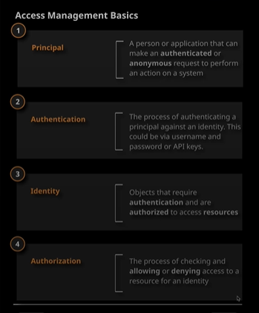

Slide 2
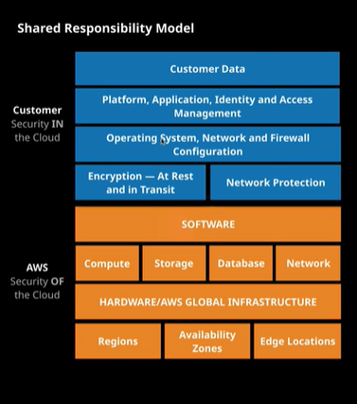

Slide 3
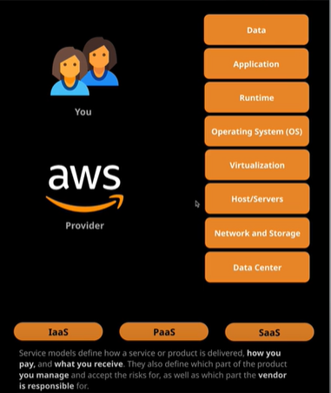
Service Models End-To-End Application Implementation Layers

Slide 4
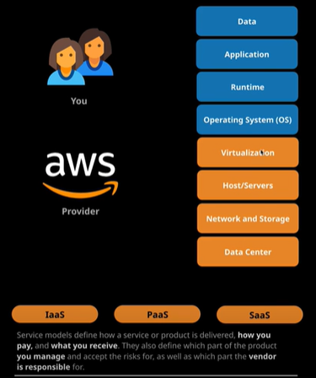
IaaS

Slide 5
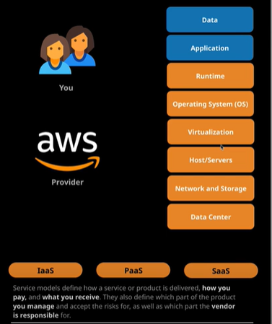
PaaS

Slide 6
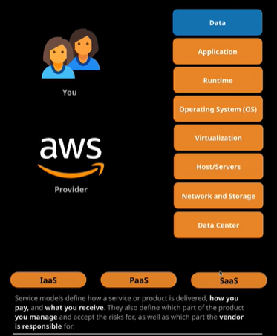
SaaS

Slide 7
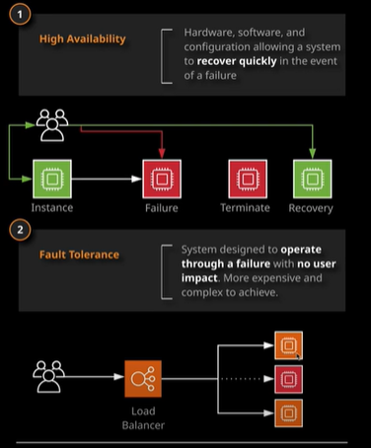
High Availability vs. Fault Tolerance High availability sometimes need downtime whereas Fault tolerance don’t. Fault tolerance is more expensive than High availability.

Slide 8
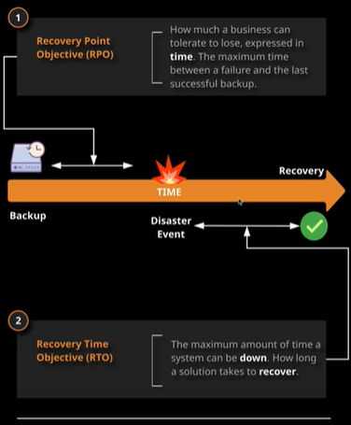
RPO vs. RTO

Slide 9
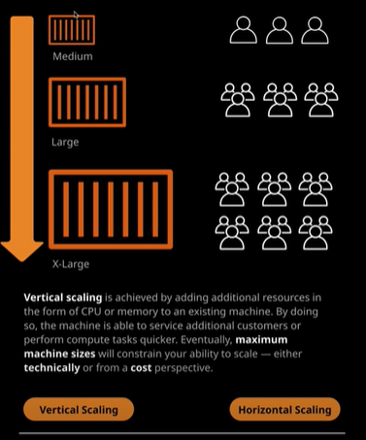
Scaling : Vertical Scaling

Slide 10
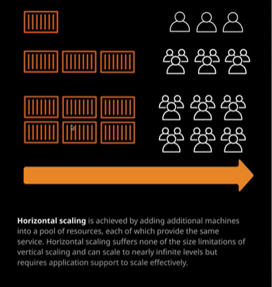
Horizontal Scaling

Slide 11
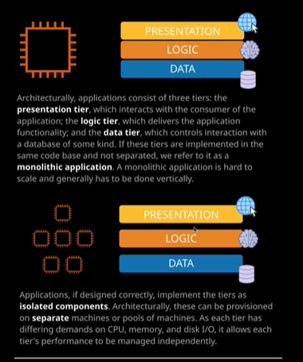
Tiered Application Design

Slide 12
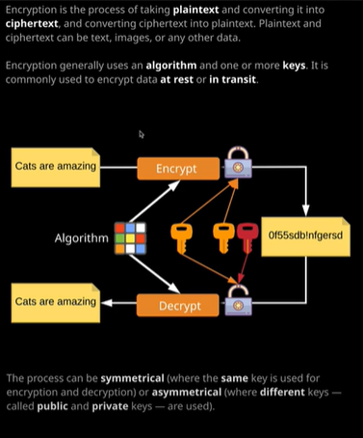
Encryption

